Slide 1

CANDLE POWER BANK
Project Presentation
By Abin George K G
Albart Saju
Anand P S
Ananthu Vijayan
Anirudh
Sradha Biju

Slide 2
Introduction
As we know, during flood one of the most challenging problem is communication. Generally we are using mobile phones to communicate with each other . But due to heavy rain the continuity of electricity may interrupt frequently ad thus charging of mobile phones is the new emerging problem
-2-

Slide 3
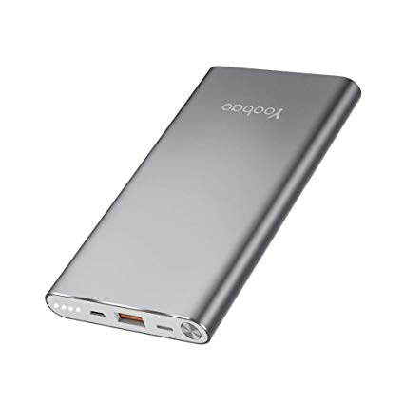
Existing Infrastructure
Present technique for charging mobile phone during flood
Power banks
Portable charging units
-3-

Slide 4
Problems with present System
It may charge the phones only 3 to 4 times and is dead
In the case of temporary charging modules may charge the
device just 30%to 50% and remaining batteries is a huge
threat to environment
-4-

Slide 5
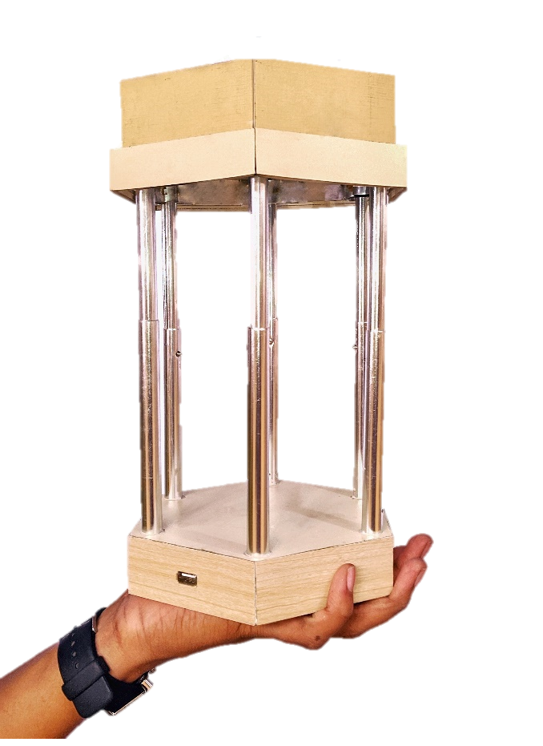
Proposed Idea
As an eco-friendly device, we are introducing Candle Power bank as a relief equipment as well as a regular use equipments for domestic uses. This device can charge any USB powered devices with just a candle
-5-

Slide 6
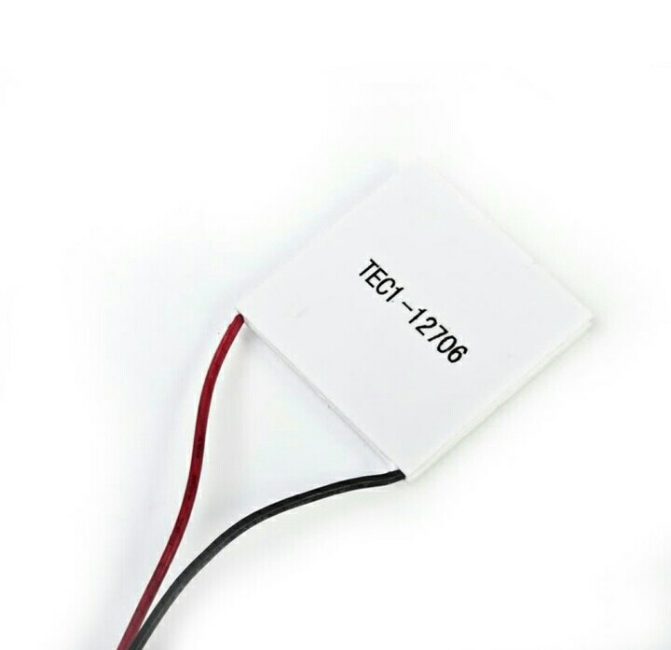
PELTIER
A Peltier cooler, heater, or thermoelectric heat pump is a solid-state active heat pump which transfers heat from one side of the device to the other, with consumption of electrical energy, depending on the direction of the current.
But in our project reverse action is
taking place
-6-

Slide 7
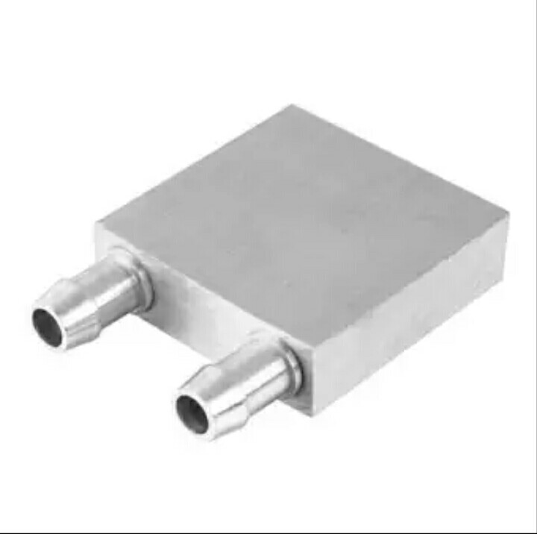
COOLING SYSTEM
Water cooling is the cooling method done here.
Water is circulated through the water blocks which are inserted above peltier module.
-7-

Slide 8
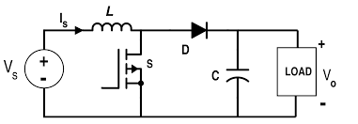
BOOST CONVERTOR
A boost converter is a DC-to-DC power converter that steps up voltage (while stepping down current)
Essentials about the circuit and operation of a step up or boost regulator using switch mode power supply techniques used in many DC-DC converters.
-8-

Slide 9
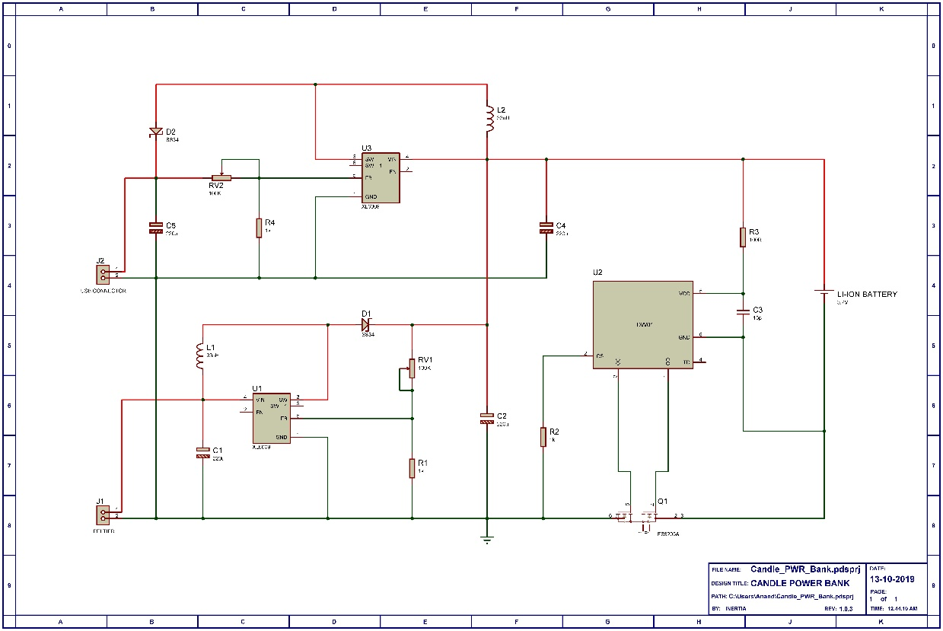
Actual Circuit Diagram
-9-

Slide 10
Basic Working Principle
BOOST CONVERTER
CHARGE CONTROLLER + BATTEY ARRAY
PELTIER MODULE
CANDLE
USB PORT
-10-

Slide 11
ADVANTAGE
This device is purely eco-friendly
It can be used as a mini room heater,if electric power is supplied into it
Produce electric power with just a candle
Almost no maintainence
Long life
Compatible with any USB devices
No charging required
-11-

Slide 12
CONCLUSION
For the need of everyone who is trapped due to flood or by anything can use this product to overcome some difficulties and may help them to escape from it.
This is not just as a product it is a saver for many.
-12-

Slide 13
If There is a Spark,
There will be a Doubt…
Thank You
-13-

